Slide 1
Chandrayyan-3
Dinesh Kumar
ISRO
Bangalore

Slide 2
Why Satellite?
Communication: Satellites enable global communication by relaying signals for television, radio, internet, and phone services. They facilitate long-distance communication, connecting people across the world.
Navigation and GPS: Satellite-based navigation systems like GPS (Global Positioning System) allow accurate positioning, navigation, and timing services for a variety of applications, including aviation, maritime navigation, and land-based navigation.
Weather Forecasting: Weather satellites monitor Earth's atmosphere, providing data used to predict weather patterns, track storms, and issue warnings for natural disasters like hurricanes, typhoons, and tsunamis.
Earth Observation: Satellites capture images and data about Earth's surface, oceans, and atmosphere. This information is used for environmental monitoring, urban planning, agriculture, forestry, and disaster assessment.
Scientific Research: Satellites support various scientific research, including astronomy, space exploration, climate studies, and environmental monitoring. They allow researchers to study distant celestial bodies, Earth's climate, and space phenomena.

Slide 3
National Security: Satellites play a critical role in national security and defense. They provide reconnaissance, surveillance, and intelligence gathering, helping monitor potential threats and geopolitical developments.
Disaster Management: Satellites aid in disaster management by assessing damage, tracking disaster progression, and coordinating response efforts during natural disasters such as earthquakes, floods, and wildfires.
Environmental Monitoring: Satellites monitor environmental changes like deforestation, pollution, and habitat loss. This information contributes to understanding and addressing environmental challenges.
Resource Management: Satellites help manage natural resources like water, minerals, and forests. They assist in monitoring resource extraction, managing fisheries, and ensuring sustainable development.
Telemedicine: Satellites enable telemedicine services, allowing medical professionals to provide remote healthcare and consultations to underserved areas or locations lacking infrastructure.

Slide 4
Education and Outreach: Satellites enhance education by providing real-time data and visuals for educational purposes. They inspire interest in science, technology, engineering, and mathematics (STEM) fields.
Global Connectivity: Satellites bridge digital divides by bringing internet access to remote and underserved areas, contributing to economic development and education.
In essence, satellites are indispensable tools that improve our daily lives, advance scientific

Slide 5
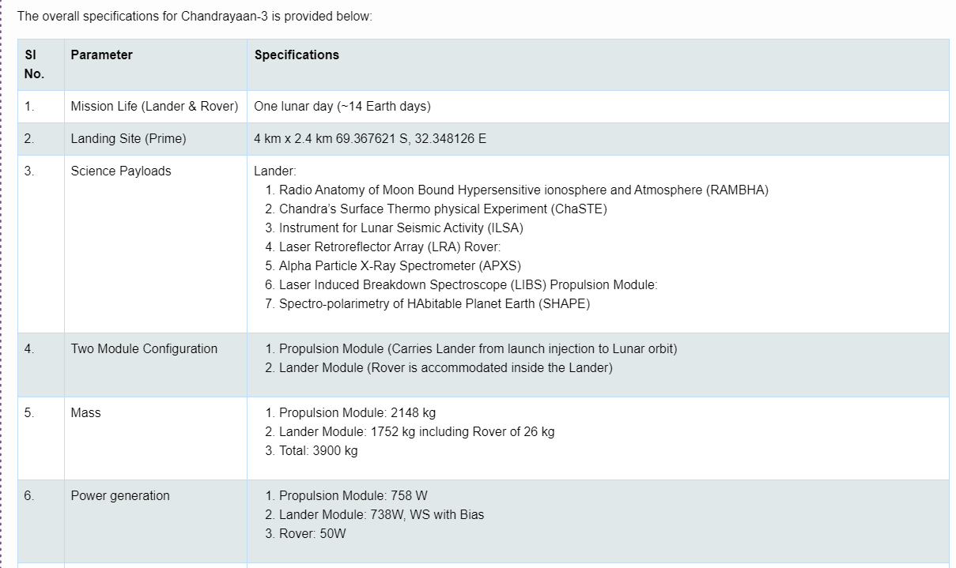

Slide 6
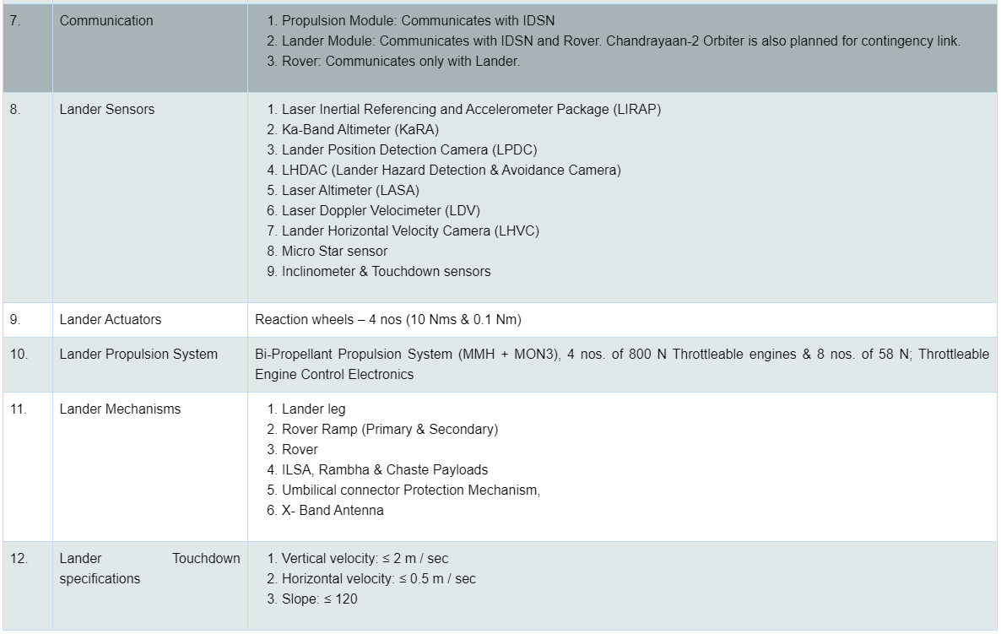

Slide 7
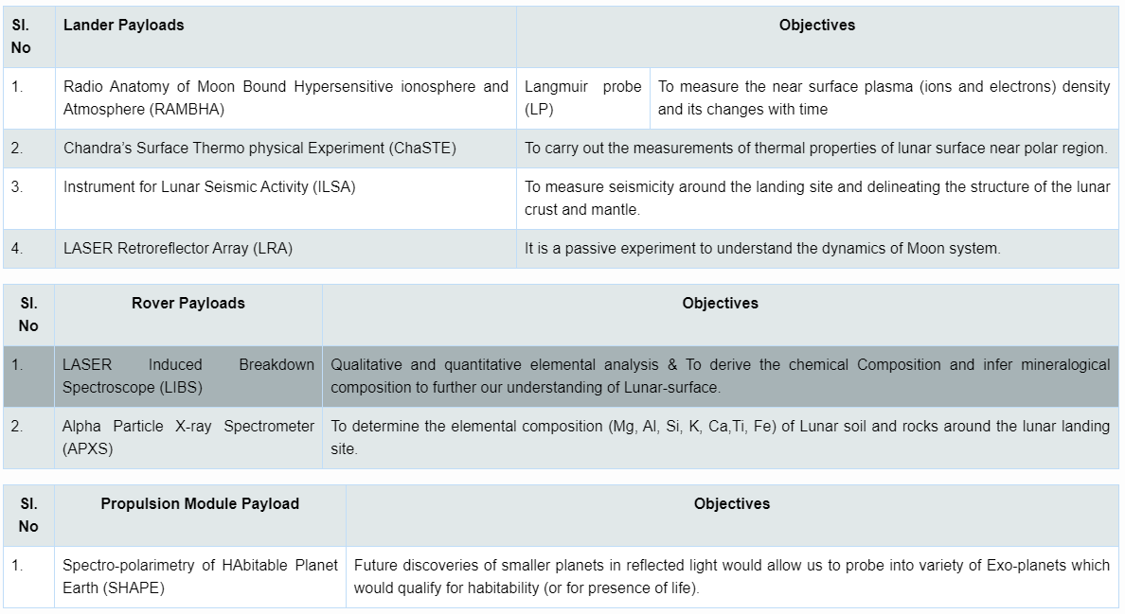

Slide 8
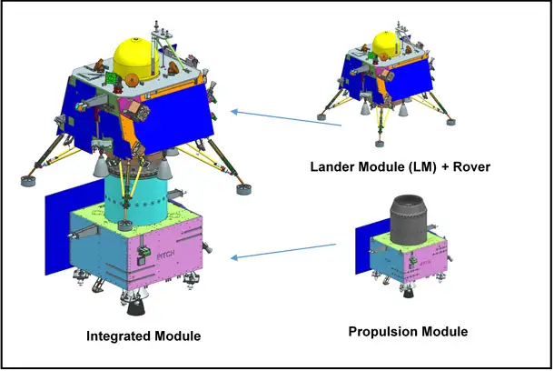

Slide 9
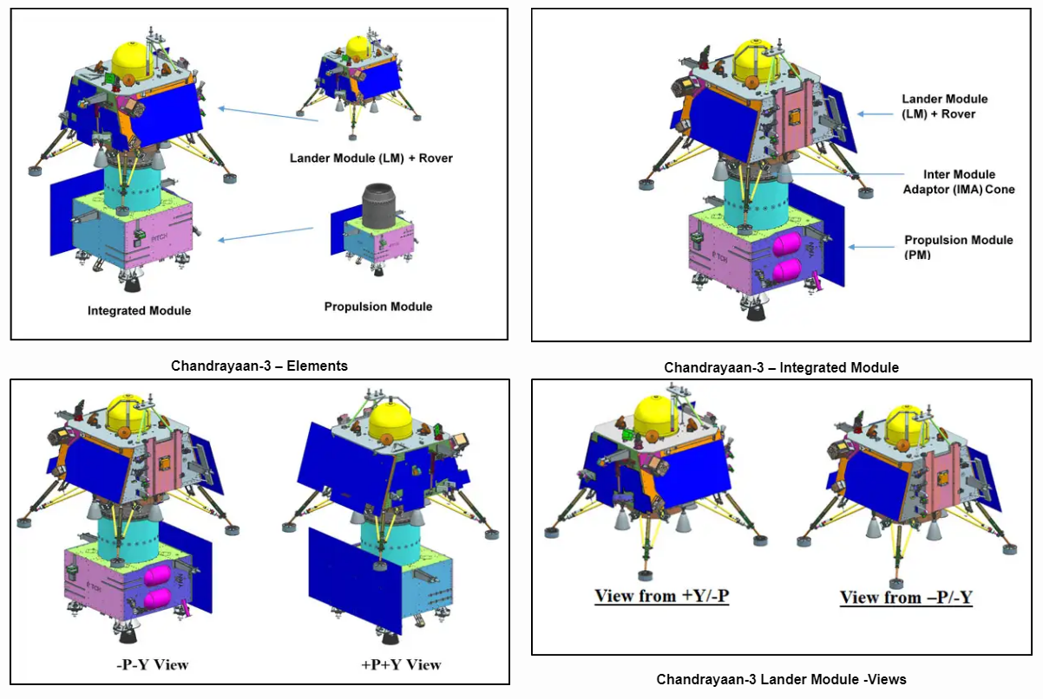

Slide 10
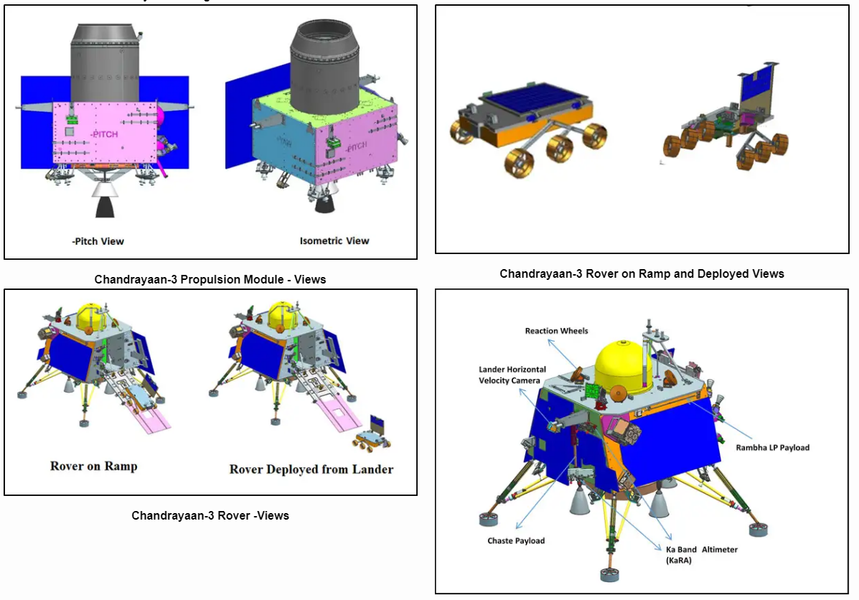

Slide 11
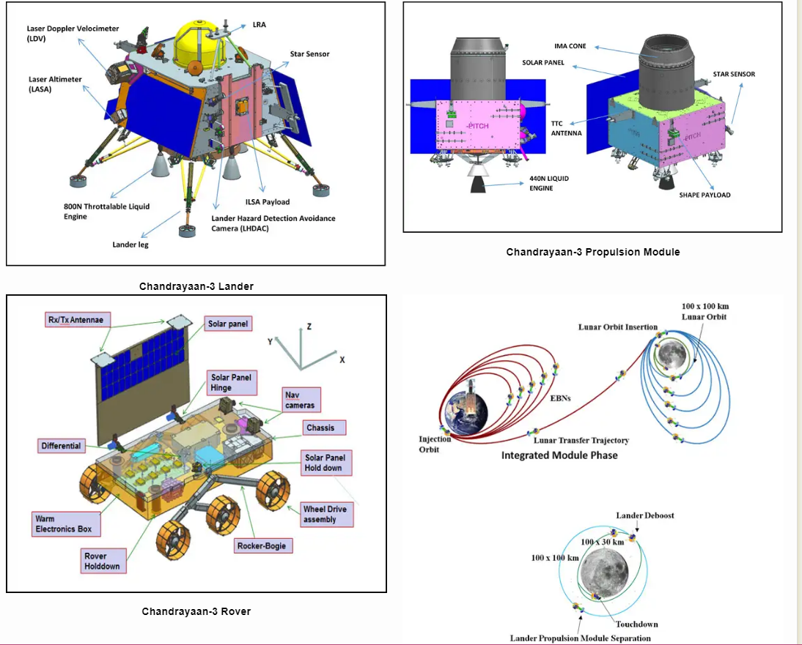

Slide 12
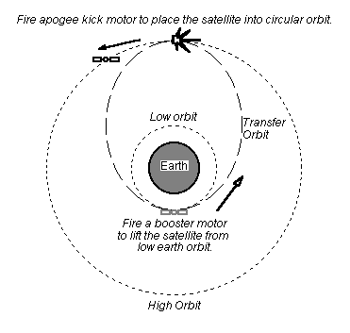

Slide 13
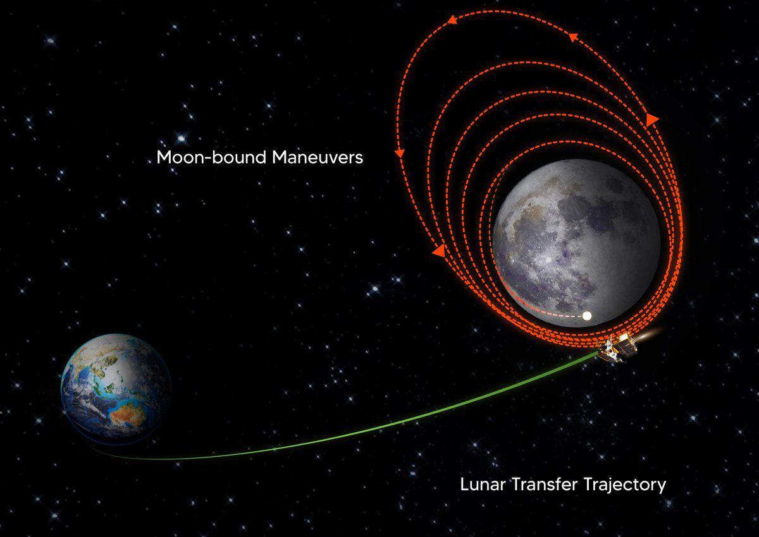

Slide 14
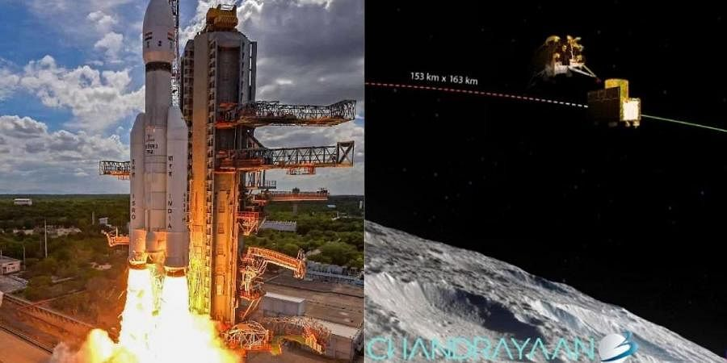

Slide 15
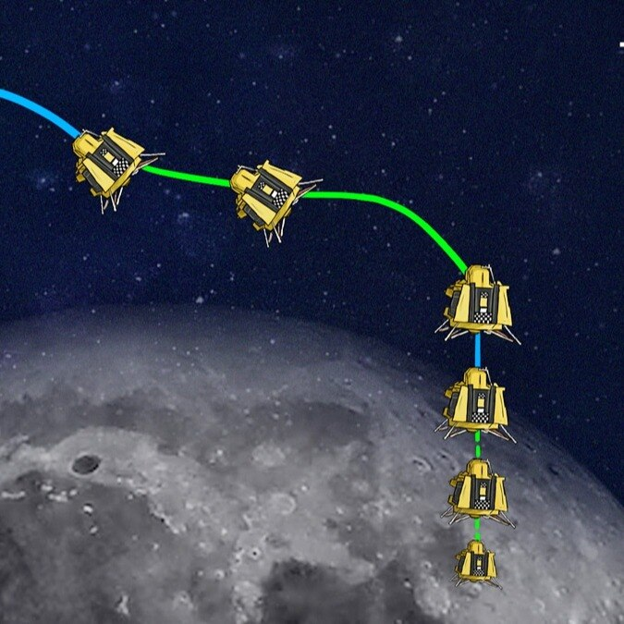

Slide 16
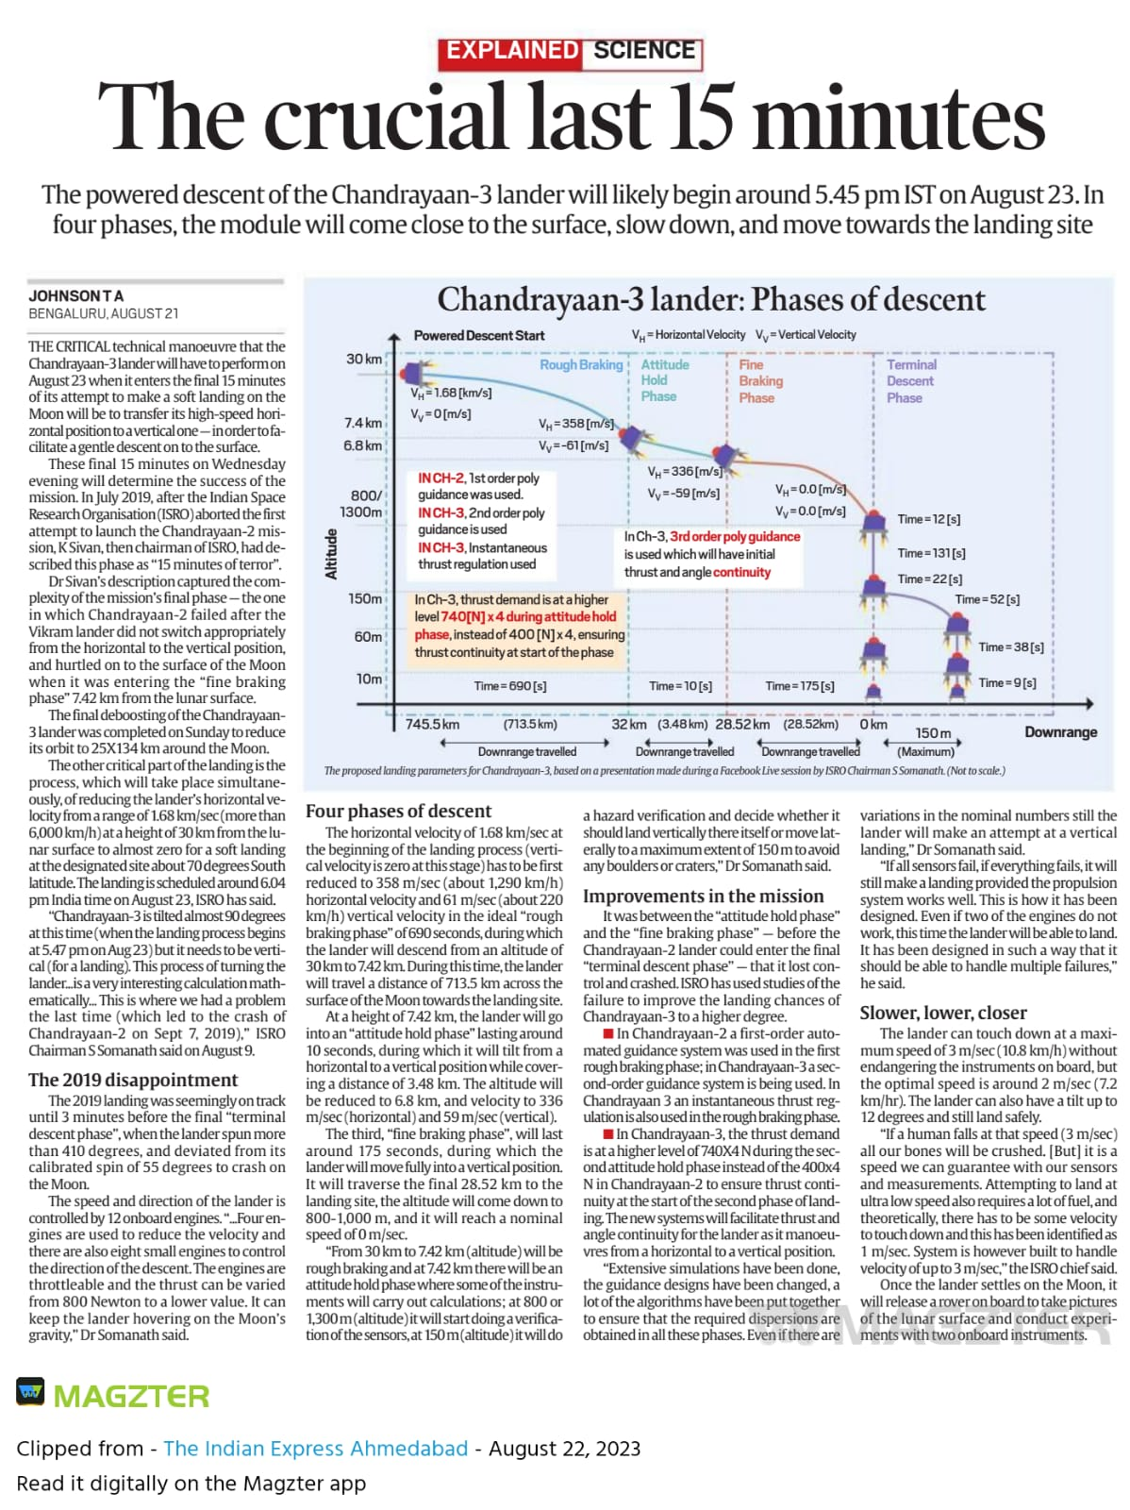

Slide 18
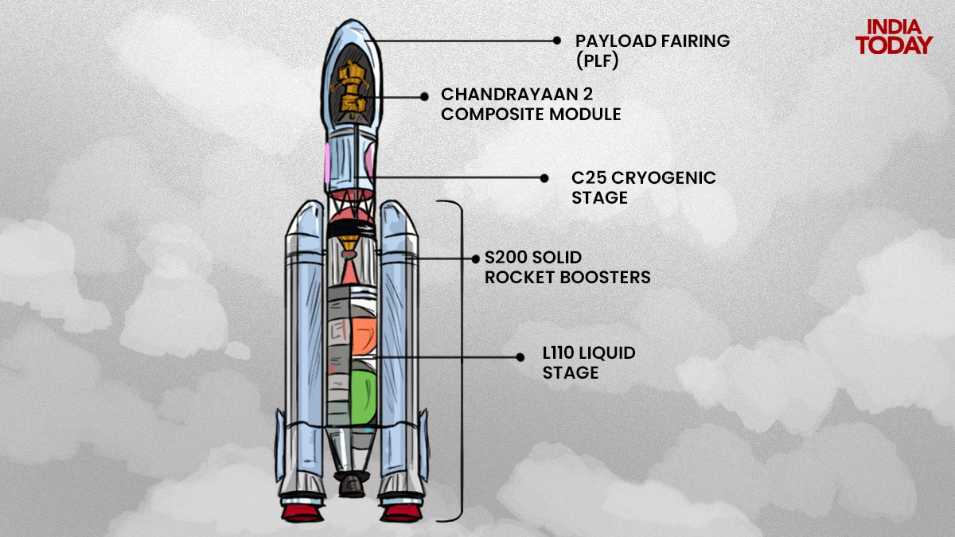

Slide 19
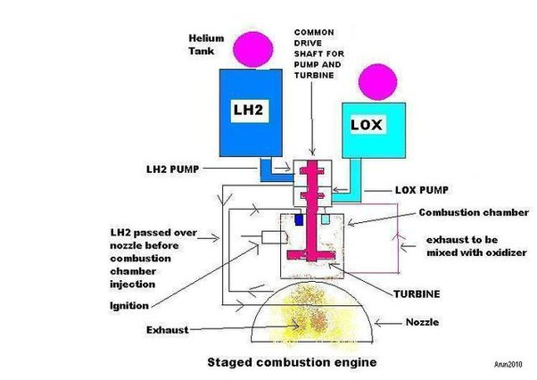
Turbine: The turbine is a rotating component that is driven by the hot gases produced during the combustion of propellants in the engine's combustion chamber. This can be thought of as similar to a wind turbine or a water turbine, but instead of wind or water, it's the high-speed and high-temperature exhaust gases from the combustion process that drive the turbine's rotation.
Pumps: The central shaft is connected to pumps that draw the cryogenic propellants (liquid oxygen, liquid hydrogen) from their storage tanks. The rotation of the shaft drives the pumps, creating the necessary pressure and flow to deliver the propellants to the combustion chamber.
Injection into Combustion Chamber: The pressurized and cooled propellants are injected into the combustion chamber of the engine, where they mix and ignite to produce thrust.

Slide 20
Three Axis Method - In this method, we can stabilize the satellite by using one or more momentum wheels. This method is called as three-axis method. The advantage of this method is that the orientation of the satellite in three axes will be controlled and no need of rotating satellite’s main body. In this method, the following three axes are considered. Roll axis is considered in the direction in which the satellite moves in orbital plane. Yaw axis is considered in the direction towards earth. Pitch axis is considered in the direction, which is perpendicular to orbital plane. These three axes are shown in below figure. Three Axis Method Let XR, YR and ZR are the roll axis, yaw axis and pitch axis respectively. These three axis are defined by considering the satellite’s position as reference. These three axes define the altitude of satellite. Let X, Y and Z are another set of Cartesian axes. This set of three axis provides the information about orientation of the satellite with respect to reference axes. If there is a change in altitude of the satellite, then the angles between the respective axes will be changed.

Slide 21
In a spacecraft, gyroscopes tell the onboard computer when the craft has changed its attitude (direction and pointing). The computer then sends the information to the spacecraft's stabilization device, which can make corrections.
What is the function of a gyro? Gyro sensors, also known as angular rate sensors or angular velocity sensors, are devices that sense angular velocity. In simple terms, angular velocity is the change in rotational angle per unit of time. Angular velocity is generally expressed in deg/s (degrees per second).
Attitude Determination and Control: Gyroscopes are used to accurately determine the satellite's orientation in space. By measuring angular velocity, they provide information about how the satellite is rotating around its various axes. This information is crucial for maintaining the desired orientation, which is especially important for imaging satellites that need to point their sensors accurately or communication satellites that need to maintain a consistent signal direction toward Earth.
Stabilization: Gyroscopes help stabilize satellites by providing feedback to onboard control systems. When external forces like solar radiation pressure, gravity gradients, or residual atmospheric drag act on a satellite, gyroscopes can detect these disturbances and help the satellite's reaction wheels or thrusters counteract them. This stabilization ensures that the satellite stays in its intended orbit and orientation.

Slide 22
Absolutely, gyroscopes are commonly used in drones for three-axis stabilization. Drones, or unmanned aerial vehicles (UAVs), require precise control over their orientation to achieve stable flight and perform various tasks effectively. Gyroscopes are essential components in achieving this stability. Here's how gyroscopes are used for three-axis stabilization in drones: Roll, Pitch, and Yaw Axes: Drones can move around three main axes: roll, pitch, and yaw. The roll axis is the lateral axis, the pitch axis is the longitudinal axis, and the yaw axis is the vertical axis. Gyroscopes are used to measure angular rates of rotation around each of these axes. Angular Rate Sensing: Gyroscopes in drones sense the angular rates of rotation around each axis. When the drone experiences external forces, like wind or changes in throttle, these forces can cause the drone to tilt, rotate, or change its orientation. Gyroscopes detect these angular rate changes and provide real-time feedback to the drone's flight controller. Flight Controller: The flight controller of a drone processes the data from the gyroscopes and uses it to adjust the motor speeds or control surfaces to counteract any undesired changes in orientation. For instance, if the drone starts to tilt to the left due to wind, the flight controller will increase the power to the motors on the right side to level the drone.

Slide 23
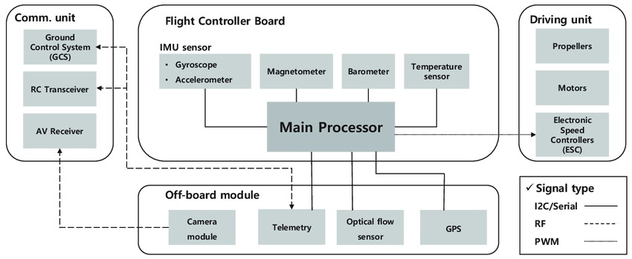

Slide 24
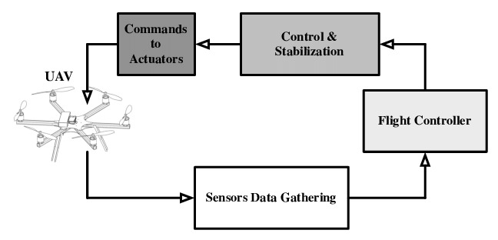

Slide 25
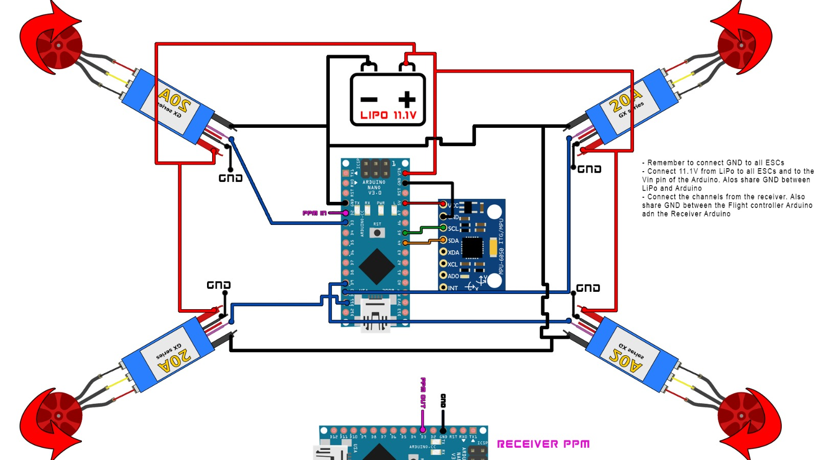

Slide 29
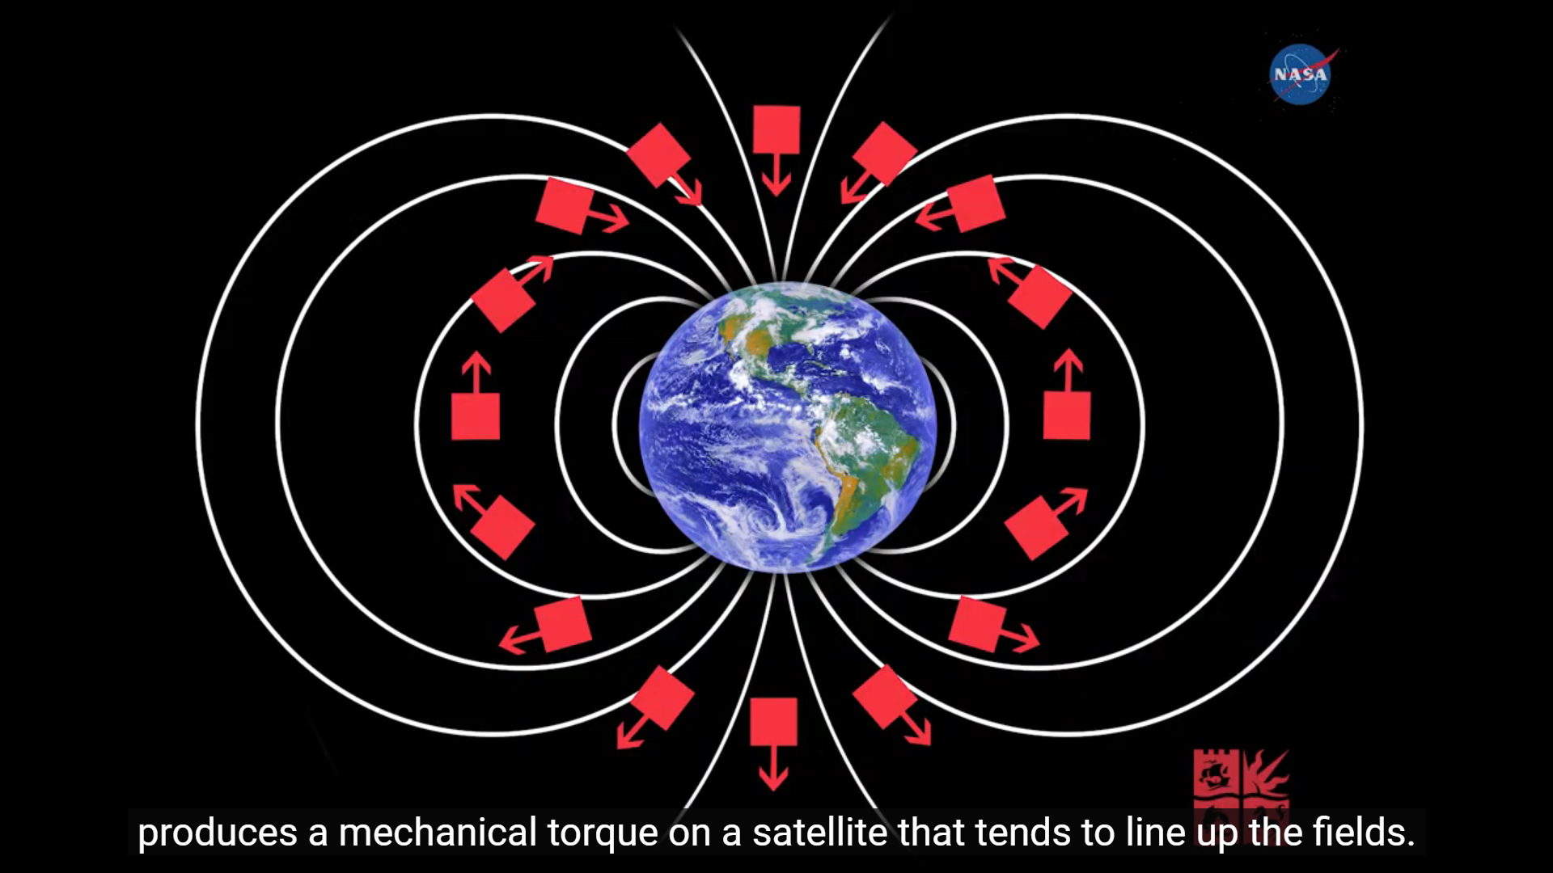

Slide 30
Earth Sensor:
Earth sensors detect the Earth's surface in the field of view of the sensor. They work by measuring the intensity of the Earth's infrared radiation.
Earth sensors are particularly useful for maintaining the satellite's nadir (downward) pointing orientation. They can also help determine the satellite's roll, pitch, and yaw angles.
Sun Sensor:
Sun sensors are used to detect the direction of the Sun's light. They contain multiple photodiodes or light-sensitive elements arranged in a pattern. By measuring the intensity of light on these elements, the satellite can determine the angle between the Sun and its own axis.
Sun sensors help the satellite maintain its solar pointing direction, which is essential for power generation (solar panels) and thermal control.

Slide 31
Star Tracker (for Celestial Reference):
A star tracker is an advanced sensor that identifies and tracks the positions of stars in the sky. By comparing the positions of stars to a star catalog, the satellite can precisely determine its orientation.
Star trackers can also be used to detect the Moon or other celestial bodies. This provides an additional reference for attitude determination, especially when stars are not visible due to factors like daylight.
The information from these sensors is processed by the satellite's onboard computer or attitude control system, which adjusts the satellite's orientation using reaction wheels, thrusters, or other control mechanisms.

Slide 32
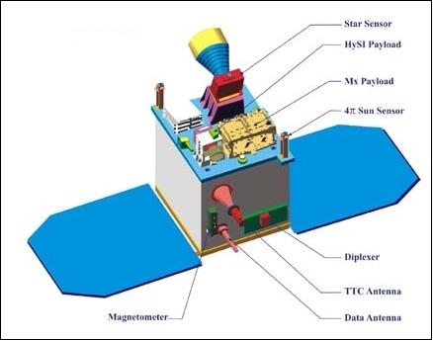

Slide 33
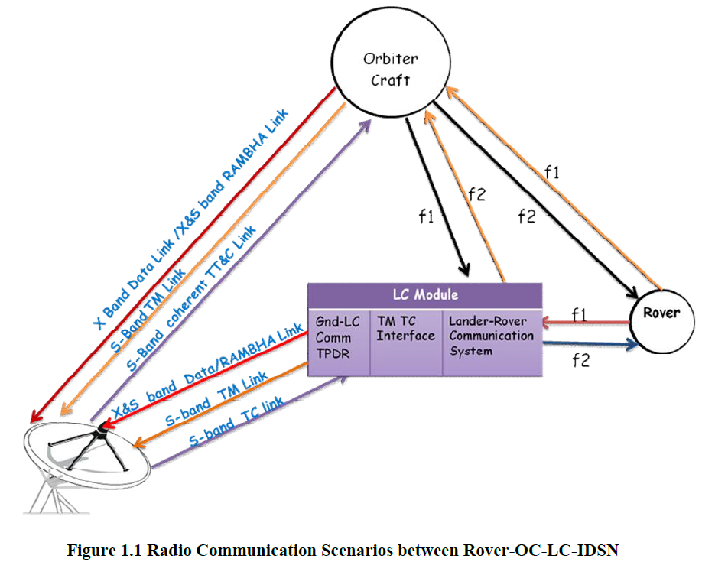

Slide 34
Battery Description
RISAT-2A s/c is provided with one Li-Ion battery of 225Ah nameplate capacity
consisting of Li-ion cells of VES180SA type procured from M/s SAFT, France. The cells are
of 45Ah capacity configured as 5P16S to achieve 225Ah. The battery is subdivided into 4
modules of 5P4S configuration for ease of fabrication, testing, handling and integration to the
s/c deck.
Solar array is the primary source of power generator for RISAT-2A satellite. The
solar cells on the solar array will convert solar radiation from the sun into usable power
through the photovoltaic process. This subsystem is designed to generate power as an
entity of the power system, which will regulate and control the distribution of power to the
other subsystems of the satellite.
The Solar Array consists of one wing three panels of size 1.9 m X 2.8 m populated
with Triple Junction Solar cells for power generation. Solar Panel substrates are sandwich
structures with CFRP face skins and 50 micron Kapton as insulator on the cell side.

Slide 35
Here are some key aspects of a grounding scheme in a satellite:
Electrical Continuity: A grounding scheme ensures that all metal parts and conductive elements within the satellite are electrically connected, creating a low-resistance pathway for electric currents. This minimizes voltage differences between different parts of the satellite and helps prevent electrostatic discharge (ESD) events.
EMI Mitigation: Proper grounding helps reduce electromagnetic interference, which can disrupt the operation of sensitive electronics on the satellite. Grounding prevents the buildup of static charges and provides a controlled path for current flow.
Signal Integrity: Grounding is crucial for maintaining signal integrity. It reduces noise and ensures that signals transmitted between different components maintain their quality and accuracy.

Slide 36
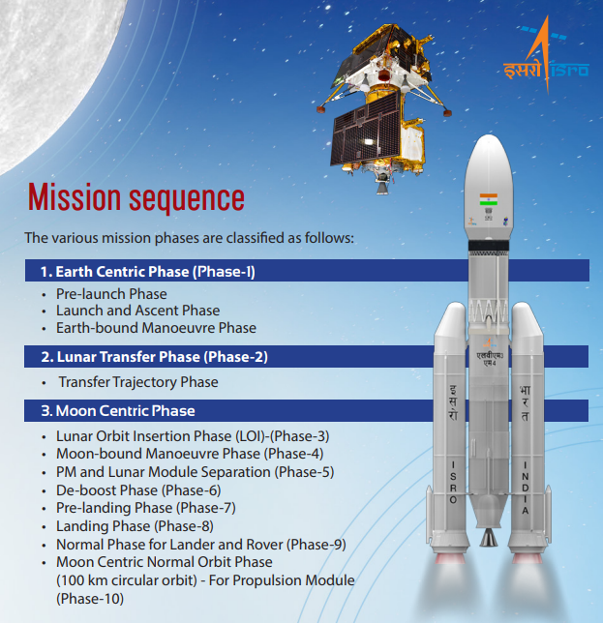

Slide 38
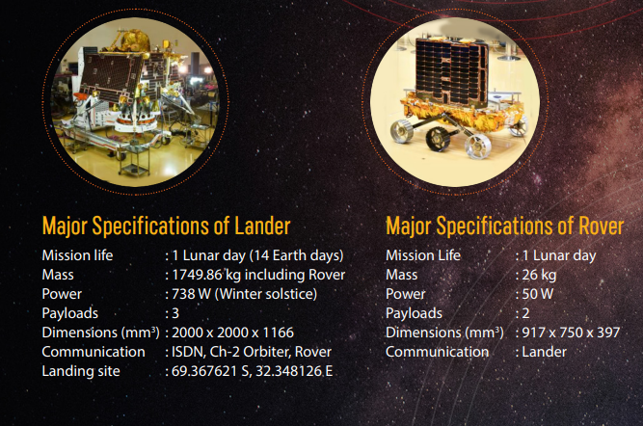

Slide 39
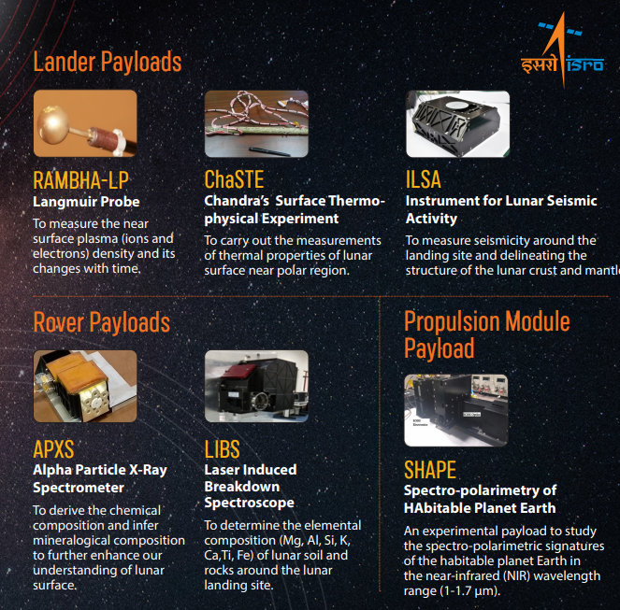

Slide 40
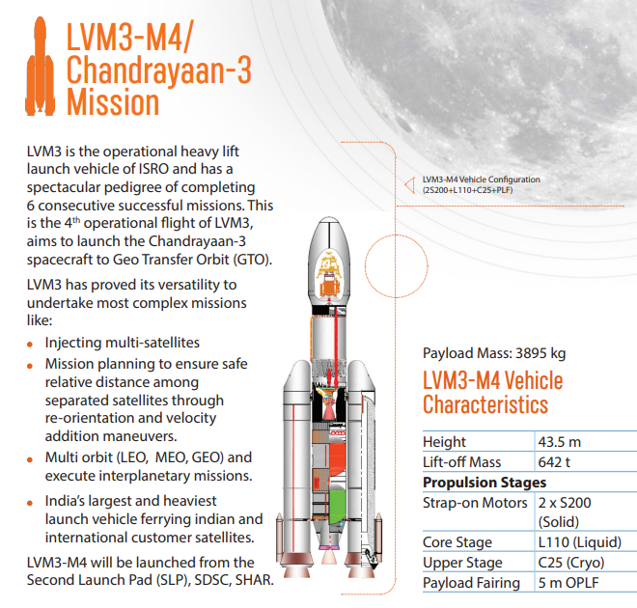

Slide 41
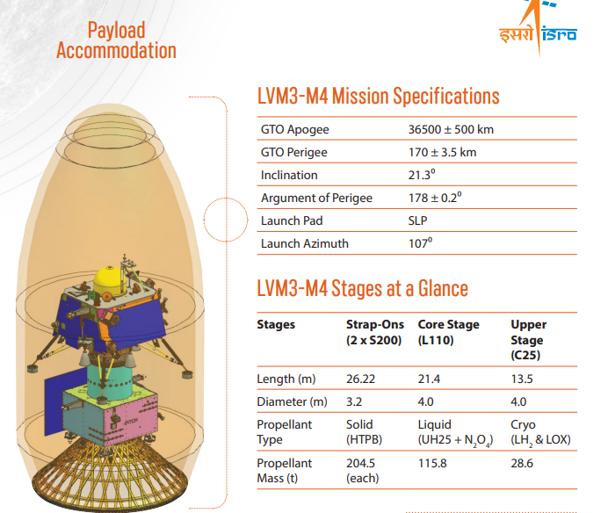

Slide 42
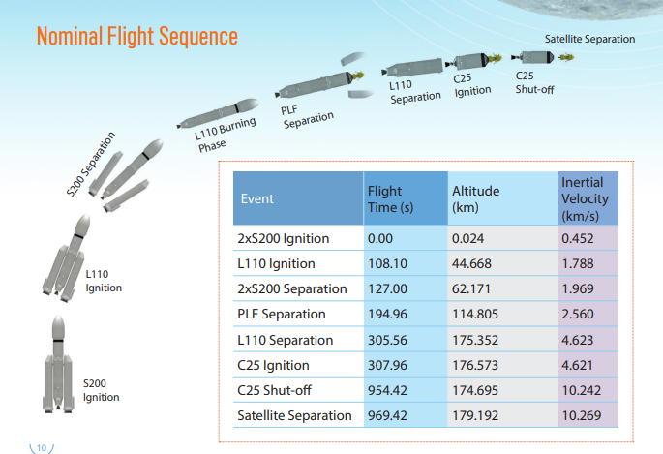

Slide 43
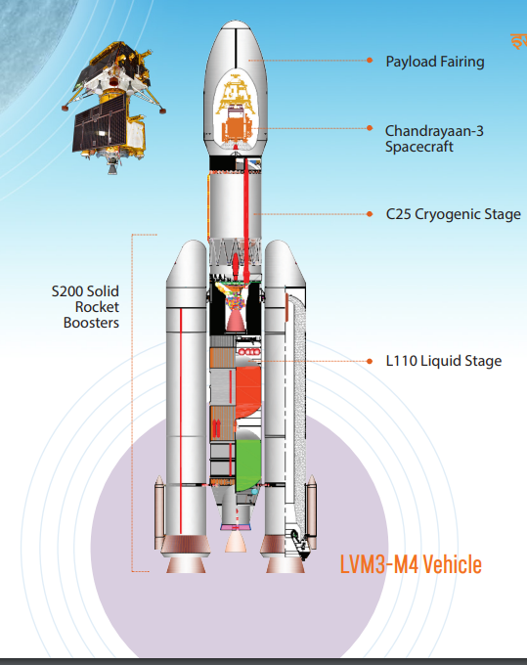

Slide 44
The heat shield “is a safety critical piece of equipment designed to protect the craft and passengers,” said Mike Sarafin, Artemis I mission manager. It will be entering the atmosphere at speeds of Mach 32 , with 5,000 degrees of heat and needs to protect a 20,000 pound spacecraft with astronauts on future missions.
Heat shields of re-entry space vehicles such as the space shuttle orbiter are made using carbon–carbon composite. This material is used in the nose cone and leading edges of the orbiter where the temperature reaches 1600 °C during re-entry.

Slide 50
The primary purpose of an apogee firing is to change the spacecraft's velocity and alter its orbit. This maneuver can serve various objectives, depending on the mission requirements:
Orbit Circularization: If a spacecraft is in an elliptical orbit (with varying distances from the central body), an apogee firing can be used to increase its velocity at the apogee. This results in a higher speed at the farthest point of the orbit, leading to a circularized orbit with a more constant altitude.
Orbit Transfer: Apogee firings can be used to transfer a spacecraft from one orbit to another. For instance, a spacecraft in a low Earth orbit might execute an apogee firing to raise its apogee and transition to a higher orbit.
Change in Orbital Inclination: By firing the engines at the apogee of its orbit, a spacecraft can change its orbital plane or inclination. This is often necessary to align the orbit with specific targets or observation requirements.
Interplanetary Missions: Spacecraft traveling to other planets may execute apogee firings to adjust their trajectories and achieve the required encounter with the target planet.
Lunar or Planetary Capture: Spacecraft entering orbit around a moon or planet can perform an apogee firing to slow down and be captured by the body's gravity.

Slide 51
The Lander Module (LM) of the Indian Space Research Organisation's (ISRO) third lunar mission Chandrayaan-3, launched on July 14, made a successfully landing on the Moon's surface on August 23, making India only the fourth country after the erstwhile USSR, the U.S. and China to make a soft landing on the lunar surface.

